Slide 1
PhD
Paramita Chakraborty

Slide 2
Problem Statement
A locomotive manufacturing unit is consistently facing failures in the engines of several locomotives of their fleet thus resulting in unexpected services and additional cost for minimizing error, repair, replacement etc.
A well defined analytical and modelling framework to predict the major possible future events/ action points for each MachineID in the next one month for each machine might help in saving time and cost.
Generating of top 10 insights for actionable items will help the business in deciding the best possible solution.

Slide 3
Data
The sensor data depicts the scheduled and unexpected services done for each machine component. Unexpected services include error, repair, replacement etc and related data is provided with time stamps.
Train & Test Data: “Train.csv” & “Test.csv” (These files consist of the MachineID & ActionPoint Which is the target attribute).
MachineDetails data : This file depicts the MachineID, model, it’s service period for both train and test MachineIDs
Minor Error information: This file consists of the details about minor errors that took place with each machine at various time stamps. Machines are still operational though the errors occurred.
Different Services Details: This file depicts the timestamp, MachineID, ServiceType, ComponentAttended etc.
Replacement Details: This file depicts the timestamp, MachineID and which component got replaced.
Operating Conditions Details: This file depicts the timestamp, MachineID, readings of different sensors at each point of time.

Slide 4
Feature Engineering Part 1
Since the prediction window is one month, the aggregation of the data is grouped by (Year,Month)
A new feature (Year+Month) has been created for all the data files
Complaints, Component Replacement, Machine Details and Component Service data are merged by this new column (Year,Month)- so now we have the Machine ID, Error ID, Component Replaced, Component Attended, Service Type, Machine Model, Service Period for each (year+month) combination
Now for the Operation Conditions data, we have each hour data for each day for all the 4 sensors for each machine. I have taken the mean of the each Sensor data for each (Year+Month) combination for each machine
There are certain machine IDs which have undergone component replacement and encountered errors, however, most of them might be working fine. So there were some Null values for some columns
New column Sum_NAs has been created to capture the null values per row
For each column having Null values, new columns were created to encode the Null values with 1 or else 0. This is to capture the Null value pattern as we would be imputing the values with mean/mode
Column ‘ErrorID’ is being imputed with a value ‘NoError’ which means the machine was working perfectly fine during that (Year+Month) period

Slide 5
Continued..
Column ‘ComponentReplacement’ is being imputed with a value ‘NoReplacement’ which means the machine was working perfectly fine during that (Year+Month) period
For the columns Sensor1, Sensor2, Sensor3, Sensor4, the null values were imputed with the means, since the data for these followed a normal distribution mostly
For Categorical Columns, ComponentAttended, ServiceType and MachineModel, the values were imputed with mode
Create 3 columns ComplainDays, CompReplaceDays and ComplainServiceDays.:
ComplainDays capture the difference in days from last time a complaint was recorded for each machine
CompReplaceDays capture the difference in days from last time a component was replaced for each machine
ComplainServiceDays capture the difference in days from last time a component was serviced/attended
New feature MachineModelPattern is created as for model2, the data distribution is different from other models across target variable ActionPoint

Slide 6
Continued..
New feature ServicePeriodPattern is created for Service Period between 3 and 10, as the data distribution is different from other Service Periods across target variable ActionPoint
Correlation plots were done among numeric variables and there was no strong correlation found (correlation was between -0.2 to 0.3)
Cluster the data into 5 clusters and add the cluster number for each row as a new feature column for the data set
The YearMonth categorical variable was found common across train and test data sets provided, and hence should be able to capture some pattern in train/test data

Slide 7
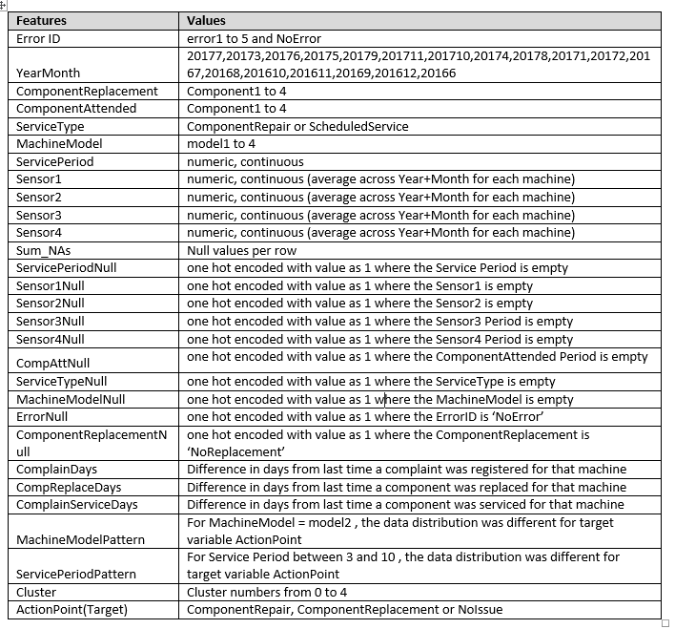
Feature List

Slide 8
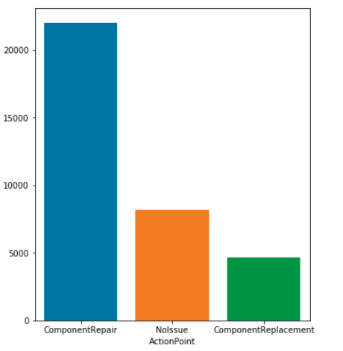
Visualization
Distribution of target classes:
ComponentRepair
NoIssue
ComponentReplacement

Slide 9
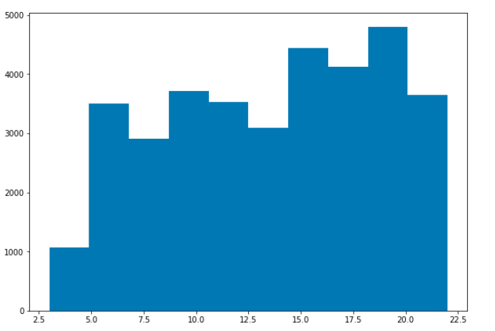
Continued..
Distribution of Service Period

Slide 10
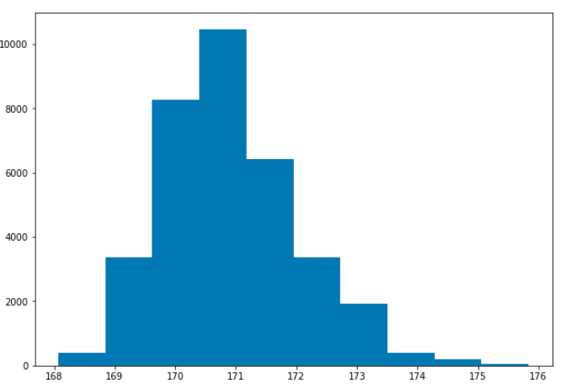
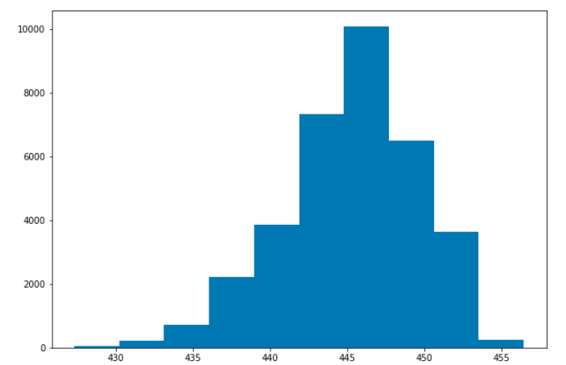
Continued…
Sensor 1 and Sensor 2

Slide 11
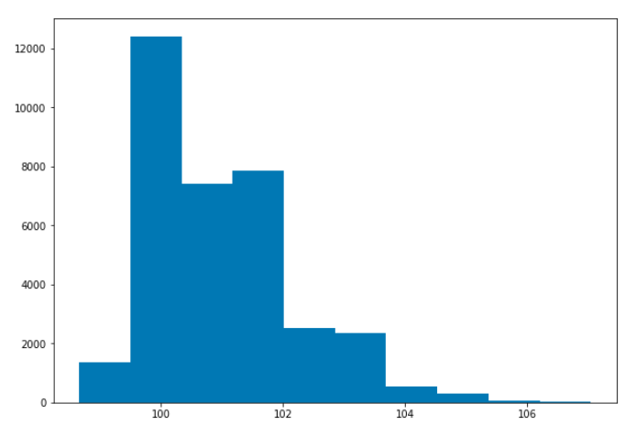
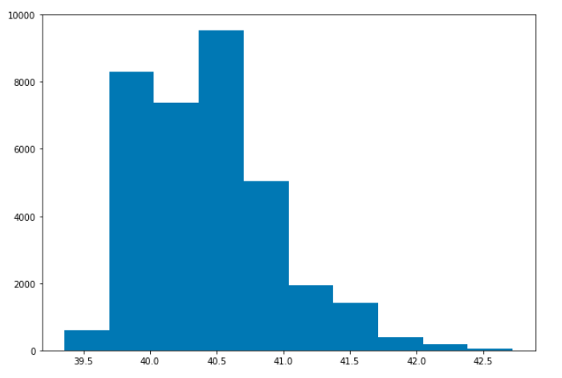
Continued…
Sensor 3 and Sensor 4

Slide 12
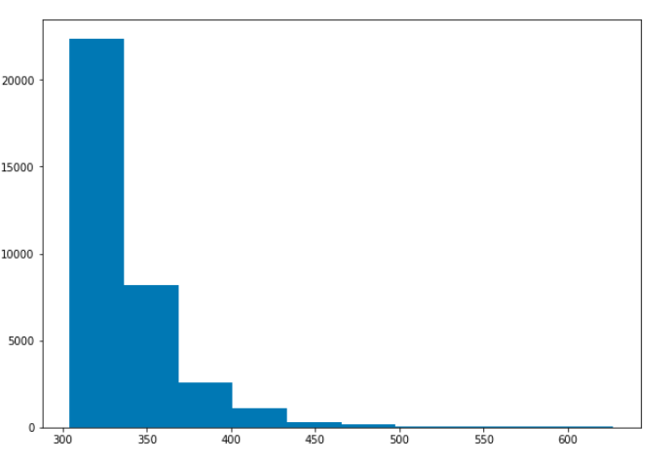
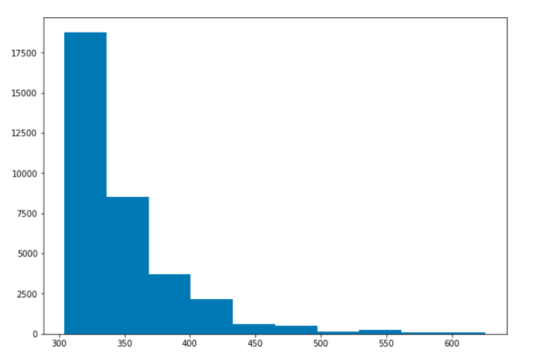
Continued…
LastComplainDays and LastCompReplaceDays

Slide 13
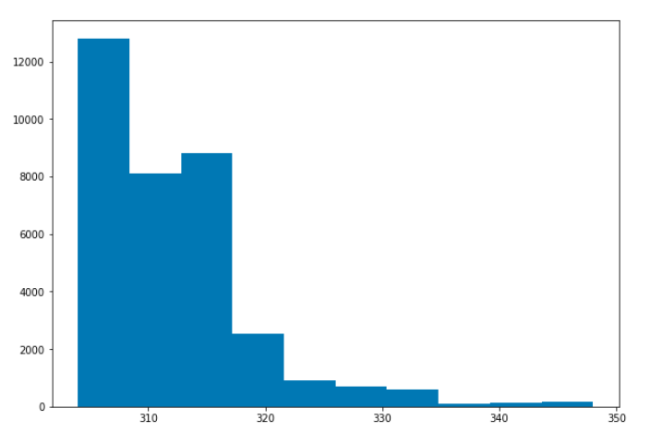
Continued…
LastComplainServiceDays

Slide 14
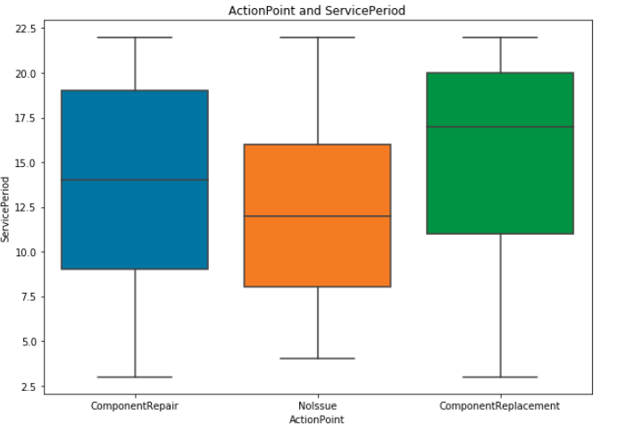
Continued…
Service Period against ActionPoint

Slide 15
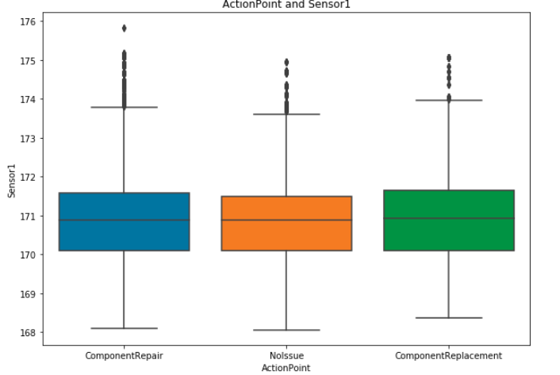
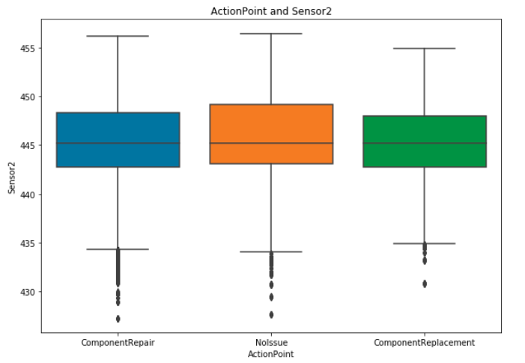
Continued…

Slide 16
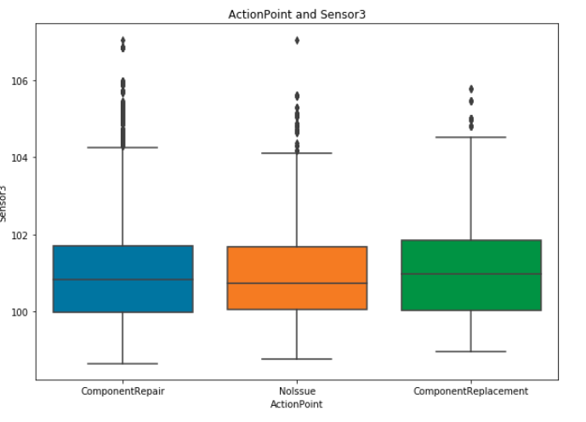
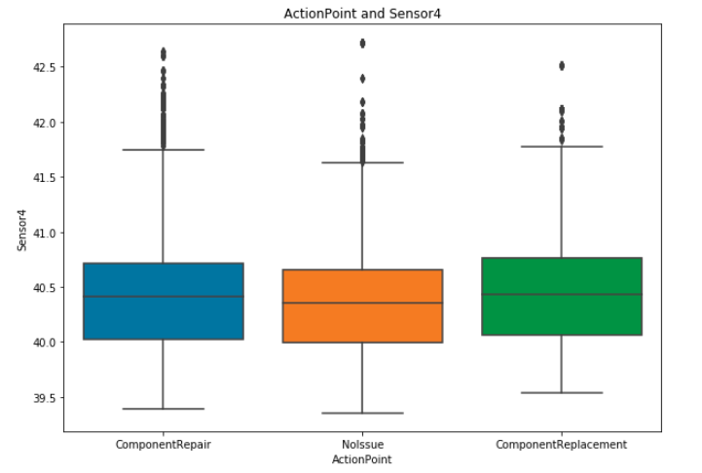
Continued…

Slide 17
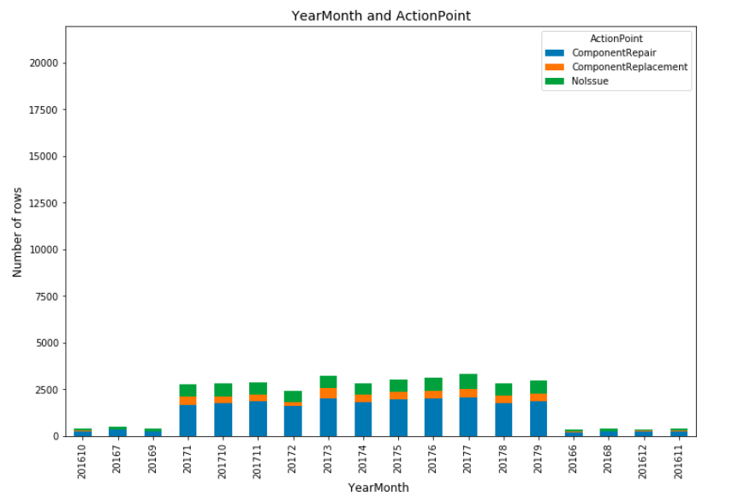
Continued…
YearMonth categorical variable Vs ActionPoint

Slide 18
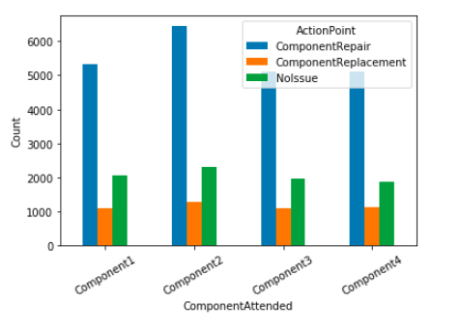
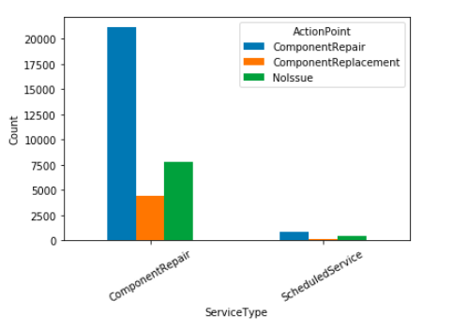
Continued..

Slide 19
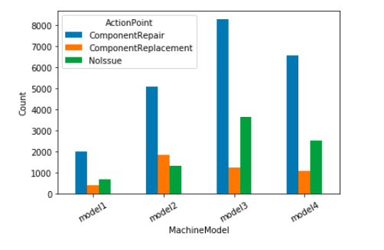
Continued…
Create feature MachineModelPattern to capture the pattern for machine model2

Slide 20
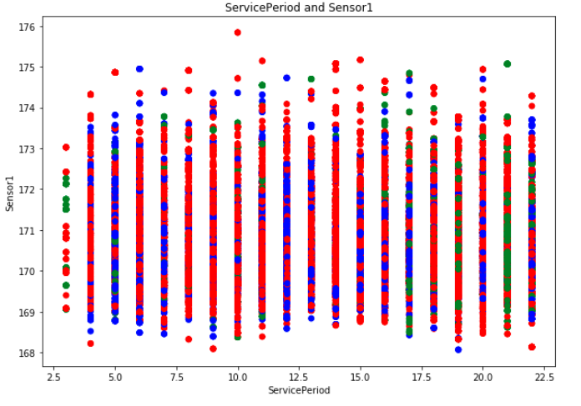
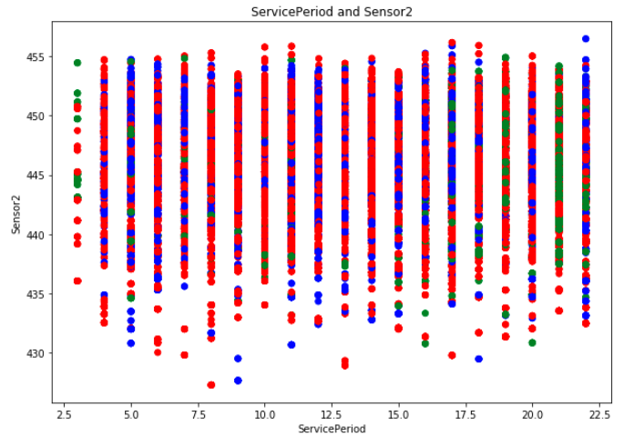
Continued…

Slide 21
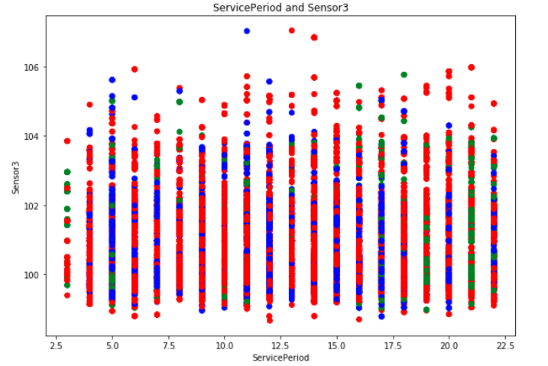
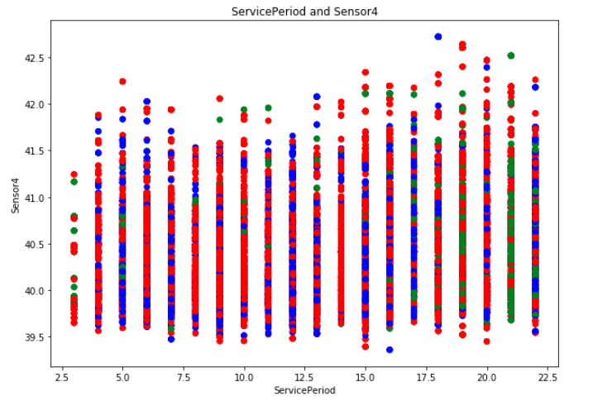
Continued…

Slide 22
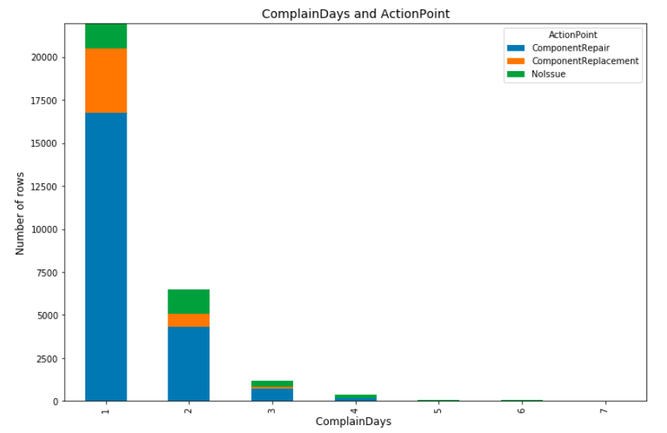
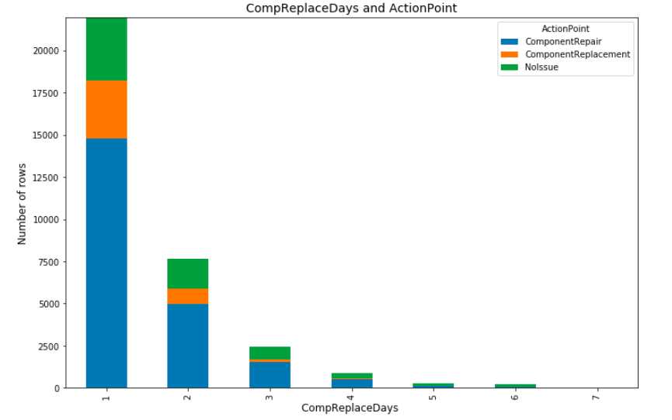
Continued…
[300,350,400,450,500,550,600,650]
[300,350,400,450,500,550,600,650]

Slide 23
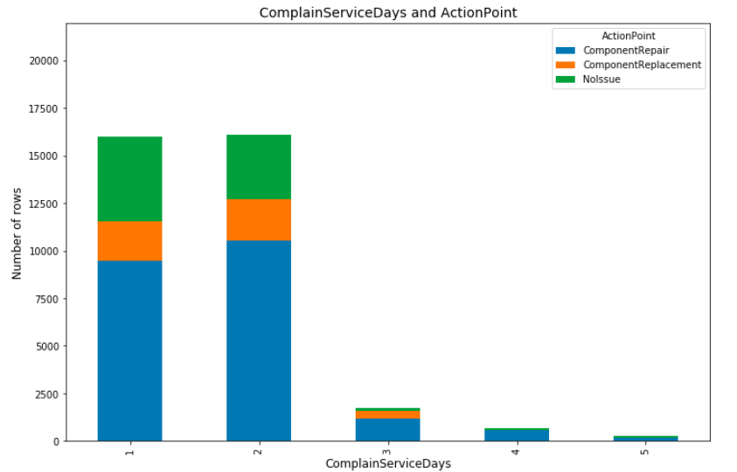
Continued…
[300,310,320,330,340]

Slide 24
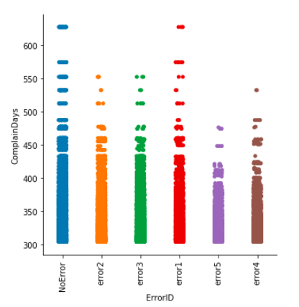
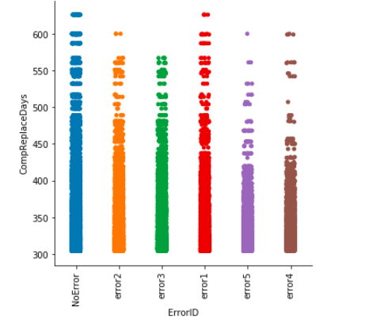
Continued…

Slide 25
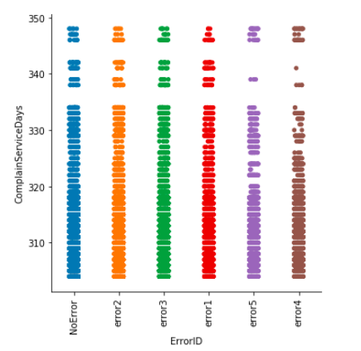
Continued…

Slide 26
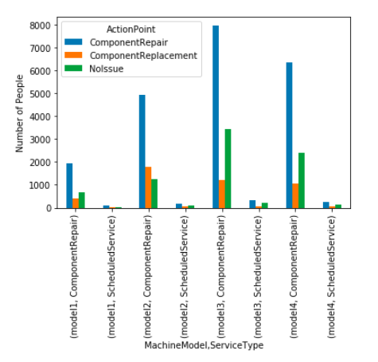
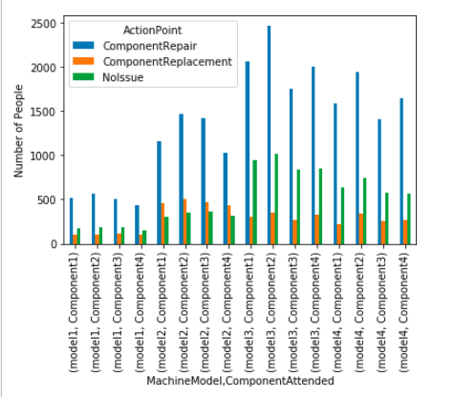
Continued(Multivariate)…

Slide 27
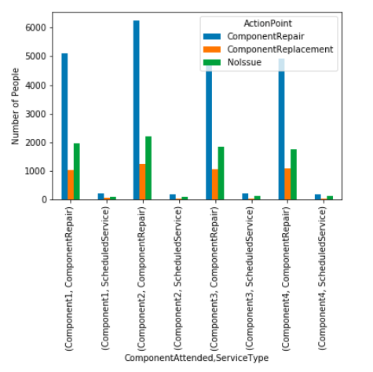
Continued(Multivariate)…

Slide 28
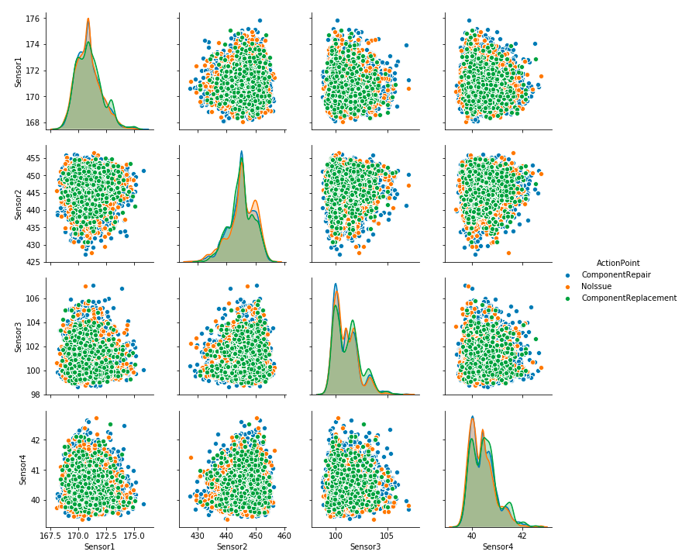
Continued(Multivariate)…

Slide 29
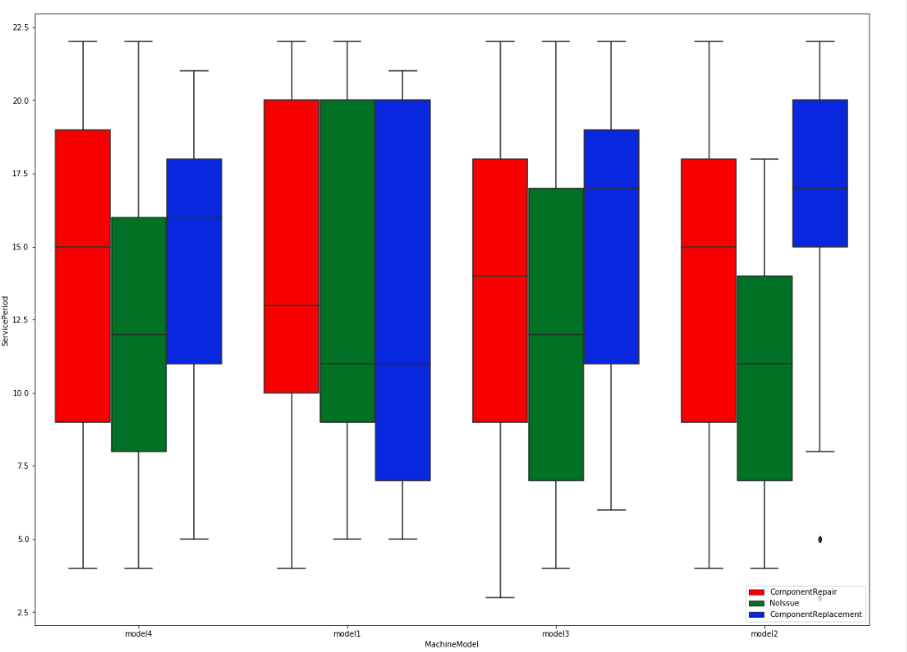
Continued(Multivariate)…

Slide 30
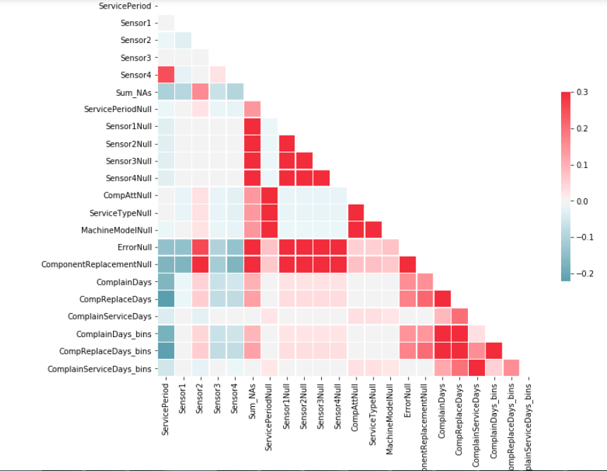
Correlation Plot

Slide 31
Model Building Part 1
Since the data is very simple, simple models to start with:
Logistic Regression with cross validation (to capture if there is linear relationship among the predictors)
Decision Trees with hyper-parameter tuning (to capture rules as the data given is unbalanced)

Slide 32
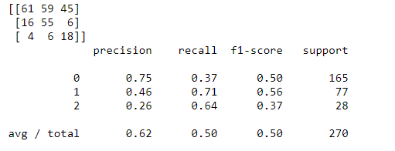
Logistic Regression with Cross Validation
The f1_score is pretty less and for class ‘Component Replacement’ (class 2 here) it is 37% only

Slide 33
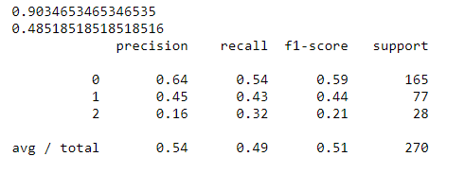
Decision Tree with hyper-parameter tuning
The f1_score is pretty less and for class ‘Component Replacement’ (class 2 here) it is 21% only

Slide 34
Feature Engineering Part 2
The 3 features created on the first submission have been retained LastComplainDays, LastCompReplaceDays and LastComplainServiceDays
ComplainDays capture the difference in days from last time a complaint was recorded for each machine
CompReplaceDays capture the difference in days from last time a component was replaced for each machine
ComplainServiceDays capture the difference in days from last time a component was serviced/attended
Created 7 features each for the Sensor data to capture the mean, median, min , max, standard deviation, skewness and kurtosis
Created 5 features Error1, Error2, Error3, Error4, Error5 which will have the count of how many times a machine had encountered these errors

Slide 35
Continued…
Created 4 features ComponentReplacement1, ComponentReplacement2, ComponentReplacement3 and ComponentReplacement4 which will have the count of how many times a machine had that component replaced
Created 4 features ComponentAttended1, ComponentAttended2, ComponentAttended3, ComponentAttended4 which will have the count of how many times a machine had that component serviced/repaired
Created 2 features ScheduledService and ComponentRepair which will have the counts of how many times a machine had undergone Scheduled Service or had it’s component repaired
Machine Model and ServicePeriod attributes have also been included in the modelling
MachineModelPattern and ServicePeriodPattern have also been included from first submission in my modelling

Slide 36
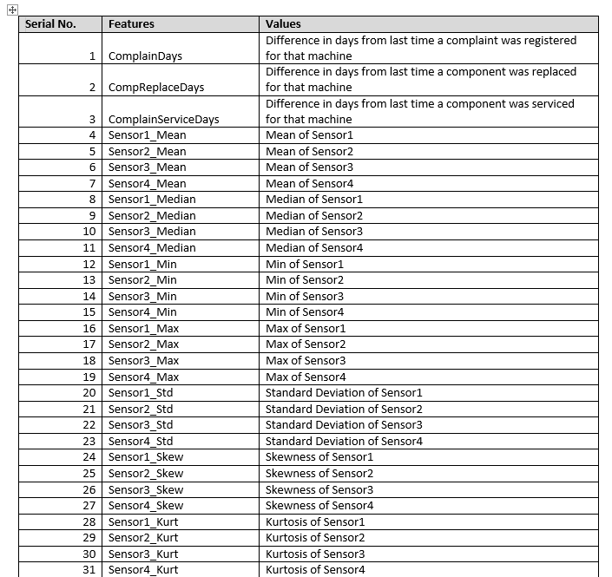
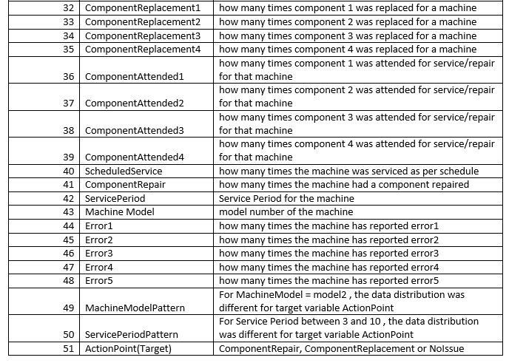
Feature List

Slide 37
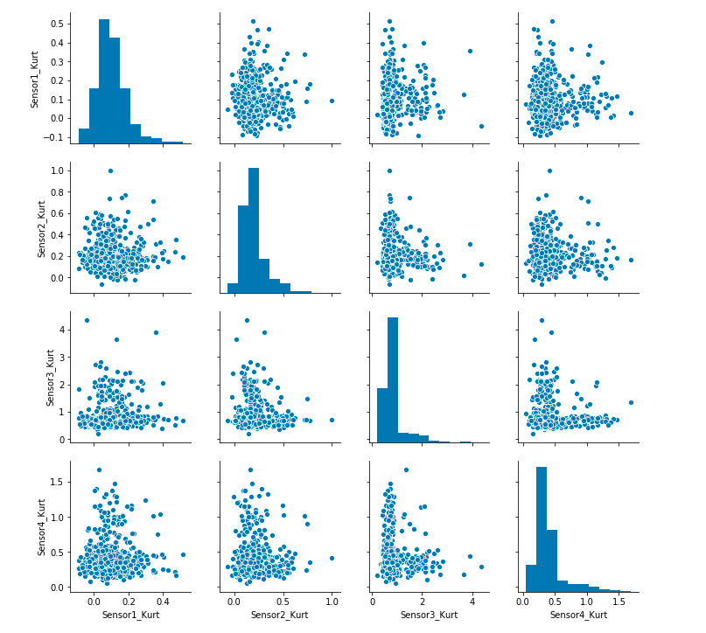
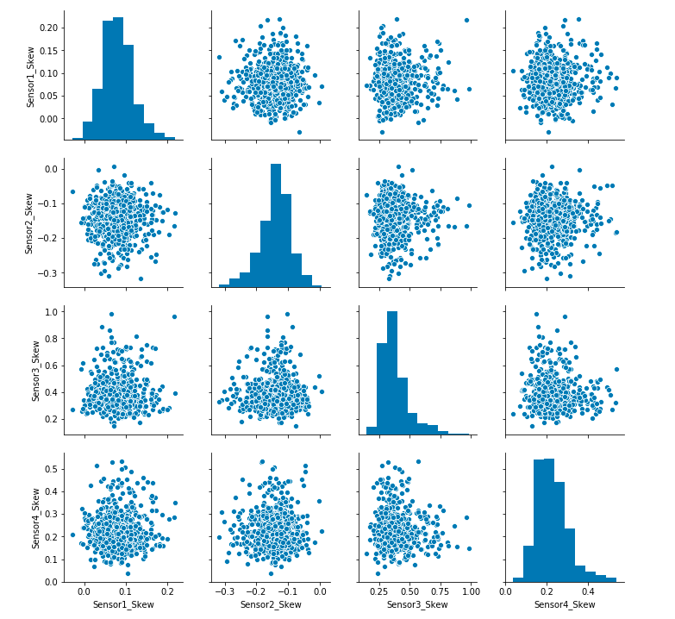
Visualization

Slide 38
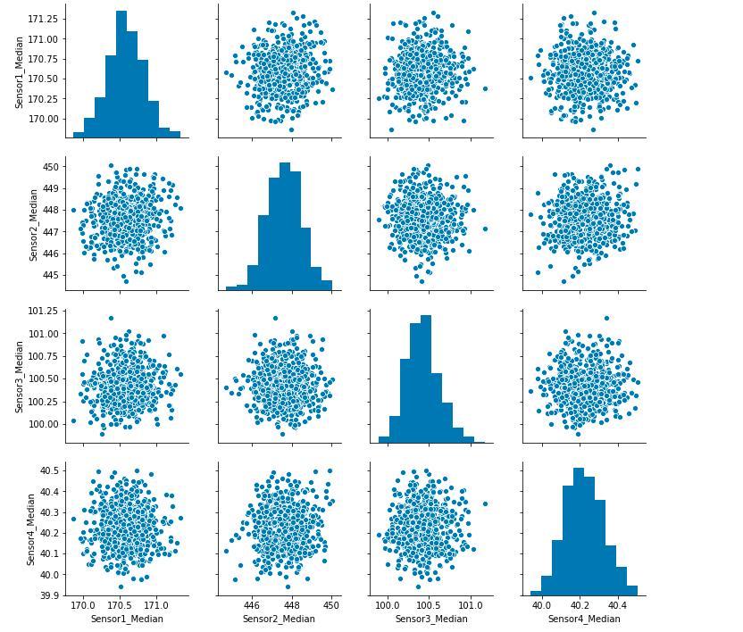
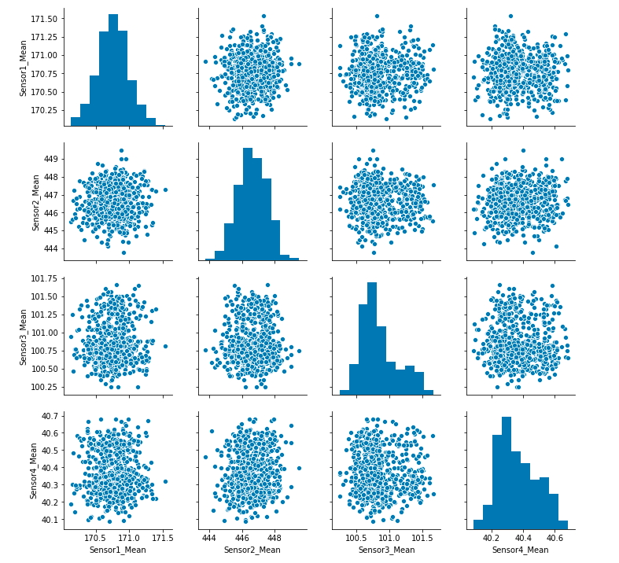
Continued…

Slide 39
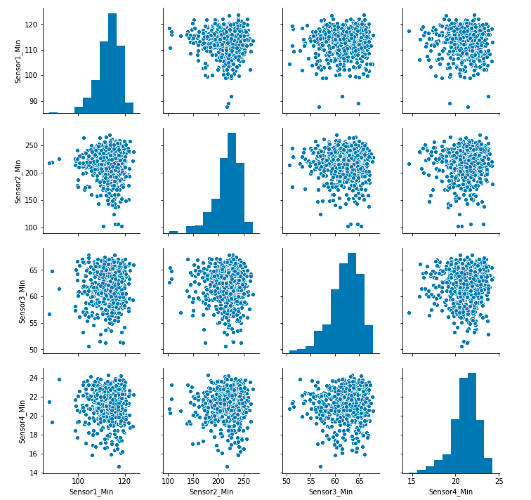
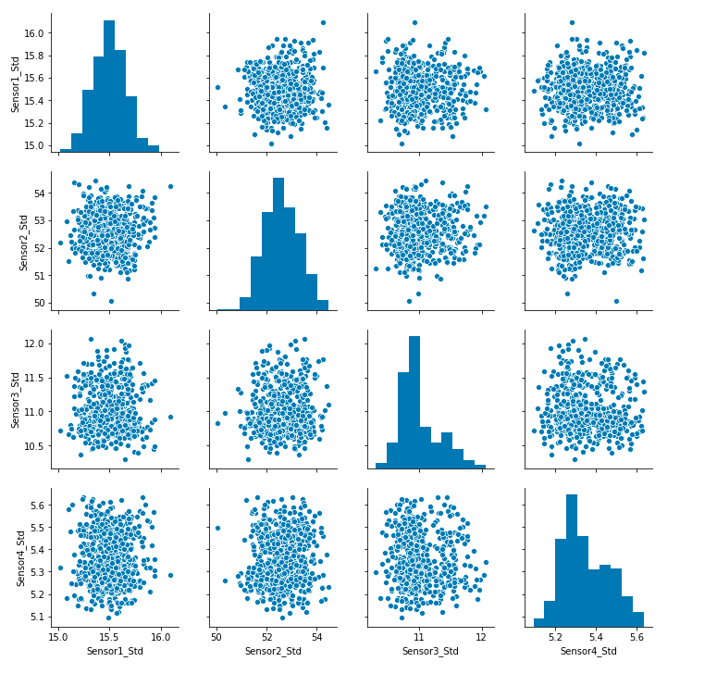
Continued…

Slide 40
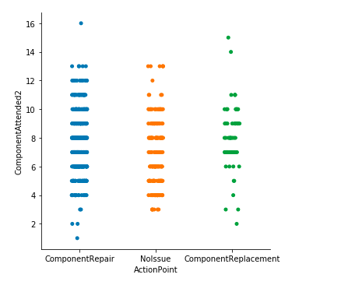
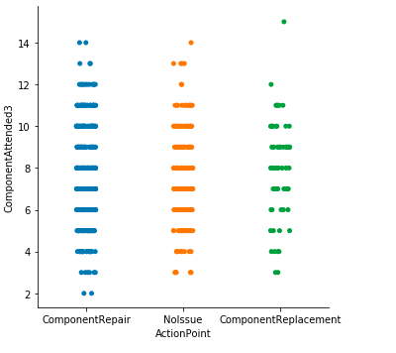
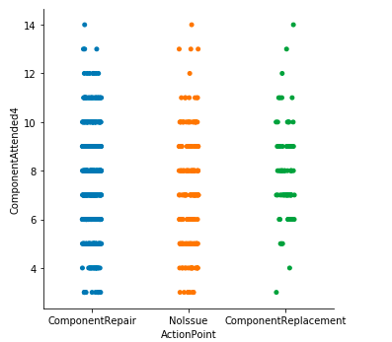
Continued…

Slide 41
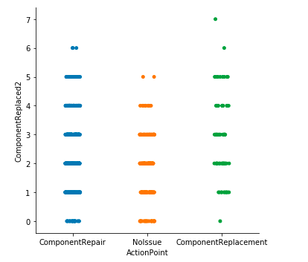
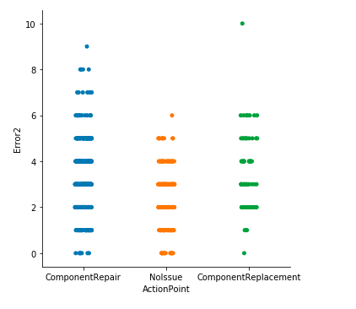

Continued…

Slide 42


Continued…

Slide 43


Continued(Multivariate)…

Slide 44

Correlation Plot

Slide 45

More Features(PCA)…
Principal Component Analysis was done and 30 features were created

Slide 46


More Features(Autoencoders)…
Using Autoencoders, 20 features were extracted

Slide 47
Models Built
Logistic Regression with and without Cross validation and hyper-parameter tuning
Decision Tree with class weights specified and cross validation/hyper-parameter tuning
SVM with rbf and linear kernels with hyper-parameter tuning
kNN Classification
Random Forest with only important variables (top 28) from Decision Tree
Random Forest using SMOTE oversampling method
Gradient Boosting with hyper parameter tuning and cost based penalize approach, specifying model weights
Stacking using Logistic, Decision Tree, SVM, Perceptron and Naaive Bayes
One Vs All Binary Classifier with SMOTE
SVM and Decision tree on top 30 PCA components
SVM and Decision tree on top 13 encoded features

Slide 48

Variable Importance Plot

Slide 49

Model Summary

Slide 50


What SVM gave better results?
In data where there are considerable more attributes than the no. of observations, SVMs are known to work pretty well. The variables 'ServicePeriodPattern','MachineModelPattern‘ were removed as they were creating unnecessary noise and bringing down the prediction f scores.
Class Labels:- 0:ComponentRepair 1: NoIssue 2:ComponentReplacement

Slide 51
What went wrong?
Test Data distribution is different from Train Data
Sensor data captured has been backfilled with some DateTimeStamp values when the component was replaced or repaired, hence during that action point the sensor data does not show any drops
Data looks to be synthesized to some extent as there are instances where the same machine (eg. MID111001) had the same component repaired, replaced and serviced at the same DateTimeStamp
Models which have low local f-score is giving high grader score

Slide 52
What could have been done?
The problem statement looks like a Time Series problem where the sensor and all other related data for each machine are available for 11 months from January 2017 till November 2017 . And we are to predict in December, for the given set of machines, which would be the ones that would have a component replaced or repaired.
So, in case the date time stamp values were accurate and had distinct values for machines when they were serviced (NoIssue), repaired (ComponentRepair) and replaced(ComponentReplacement), we can formulate a time series problem.
The time series window can be taken as 30 days and the corresponding target/label would have values as NoIssue, ComponentRepair or ComponentReplacement depending on which action has been taken in that window for that machine

Slide 53
Continued…
The train and test can then be split as first 9 months from Jaunary till September and from October till November respectively
We could then train the data using GBM or DNN and predicted on the test data for the given machine IDs for the month of December

Slide 54
Recommendations
Understand from the Locomotive Company Data Team as to how the Sensor Data has been captured as the data does not show significant spikes or drops
Obtain proper logs of when a component has been replaced or repaired and was it under Scheduled Service or Component Repair
Since the models built are not very reliable, hence try to get more data from them to analyze and look for some distinct patterns

Slide 55
Thank You

